Slide 1
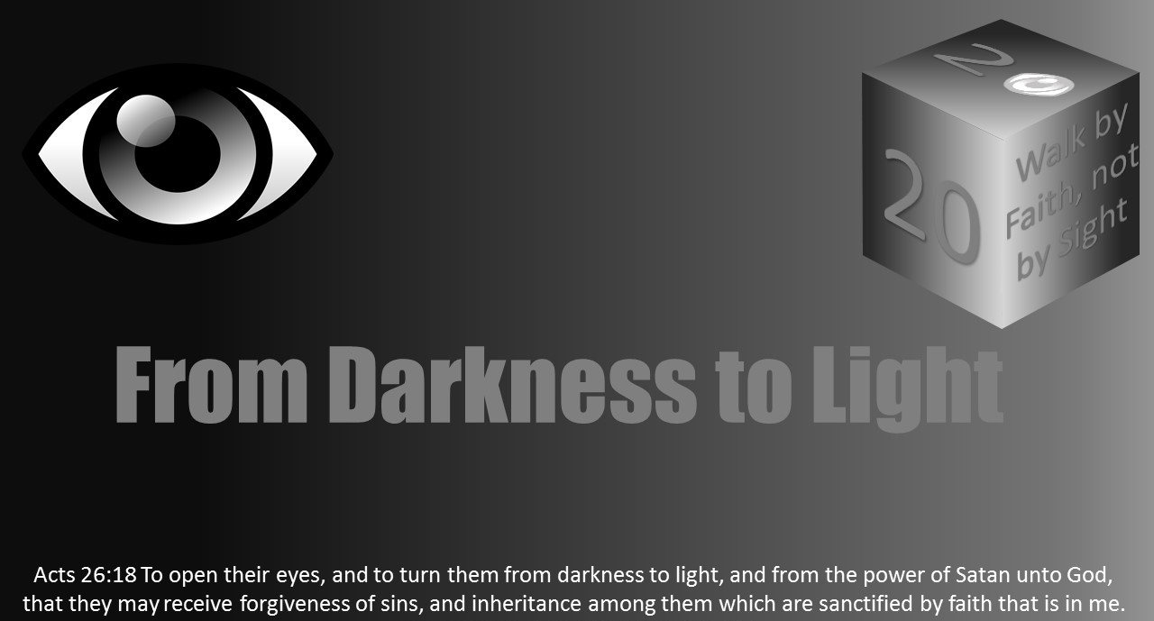


Slide 2
Light Lesson 25 In the Twinkling of an Eye

Slide 3
1 Corinthians 15:48-53 As is the earthy, such are they also that are earthy: and as is the heavenly, such are they also that are heavenly. 49 And as we have borne the image of the earthy, we shall also bear the image of the heavenly. 50 Now this I say, brethren, that flesh and blood cannot inherit the kingdom of God; neither doth corruption inherit incorruption. 51 Behold, I shew you a mystery; We shall not all sleep, but we shall all be changed, 52 In a moment, in the twinkling of an eye, at the last trump: for the trumpet shall sound, and the dead shall be raised incorruptible, and we shall be changed. 53 For this corruptible must put on incorruption, and this mortal must put on immortality. 54 So when this corruptible shall have put on incorruption, and this mortal shall have put on immortality, then shall be brought to pass the saying that is written, Death is swallowed up in victory.

Slide 4
1 Thessalonians 4:13-18 But I would not have you to be ignorant, brethren, concerning them which are asleep, that ye sorrow not, even as others which have no hope. 14 For if we believe that Jesus died and rose again, even so them also which sleep in Jesus will God bring with him. 15 For this we say unto you by the word of the Lord, that we which are alive and remain unto the coming of the Lord shall not prevent them which are asleep. 16 For the Lord himself shall descend from heaven with a shout, with the voice of the archangel, and with the trump of God: and the dead in Christ shall rise first: 17 Then we which are alive and remain shall be caught up together with them in the clouds, to meet the Lord in the air: and so shall we ever be with the Lord. 18 Wherefore comfort one another with these words.

Slide 5
John 11:25-26 Jesus said unto her, I am the resurrection, and the life: he that believeth in me, though he were dead, yet shall he live: 26 And whosoever liveth and believeth in me shall never die. Believest thou this?

Slide 6
2 Thessalonians 1:6-10 Seeing it is a righteous thing with God to recompense tribulation to them that trouble you;7 And to you who are troubled rest with us, when the Lord Jesus shall be revealed from heaven with his mighty angels,8 In flaming fire taking vengeance on them that know not God, and that obey not the gospel of our Lord Jesus Christ:9 Who shall be punished with everlasting destruction from the presence of the Lord, and from the glory of his power;10 When he shall come to be glorified in his saints, and to be admired in all them that believe (because our testimony among you was believed) in that day.

Slide 7
Mark 13:32-37 But of that day and that hour knoweth no man, no, not the angels which are in heaven, neither the Son, but the Father. 33 Take ye heed, watch and pray: for ye know not when the time is. 34 For the Son of man is as a man taking a far journey, who left his house, and gave authority to his servants, and to every man his work, and commanded the porter to watch. 35 Watch ye therefore: for ye know not when the master of the house cometh, at even, or at midnight, or at the cockcrowing, or in the morning: 36 Lest coming suddenly he find you sleeping. 37 And what I say unto you I say unto all, Watch.

Slide 8
Luke 17:26-36 And as it was in the days of Noe, so shall it be also in the days of the Son of man. 27 They did eat, they drank, they married wives, they were given in marriage, until the day that Noe entered into the ark, and the flood came, and destroyed them all. 28 Likewise also as it was in the days of Lot; they did eat, they drank, they bought, they sold, they planted, they builded; 29 But the same day that Lot went out of Sodom it rained fire and brimstone from heaven, and destroyed them all. 30 Even thus shall it be in the day when the Son of man is revealed. 31 In that day, he which shall be upon the housetop, and his stuff in the house, let him not come down to take it away: and he that is in the field, let him likewise not return back. 32 Remember Lot's wife. 33 Whosoever shall seek to save his life shall lose it; and whosoever shall lose his life shall preserve it. 34 I tell you, in that night there shall be two men in one bed; the one shall be taken, and the other shall be left. 35 Two women shall be grinding together; the one shall be taken, and the other left. 36 Two men shall be in the field; the one shall be taken, and the other left.

Slide 9
Matthew 16:27-28 For the Son of man shall come in the glory of his Father with his angels; and then he shall reward every man according to his works. 28 Verily I say unto you, There be some standing here, which shall not taste of death, till they see the Son of man coming in his kingdom.
Romans 13:11-12 that, knowing the time, that now it is high time to awake out of sleep: for now is our salvation nearer than when we believed. 12 The night is far spent, the day is at hand: let us therefore cast off the works of darkness, and let us put on the armour of light.

Slide 10
James 5:7-10 Be patient therefore, brethren, unto the coming of the Lord. Behold, the husbandman waiteth for the precious fruit of the earth, and hath long patience for it, until he receive the early and latter rain. 8 Be ye also patient; stablish your hearts: for the coming of the Lord draweth nigh. 9 Grudge not one against another, brethren, lest ye be condemned: behold, the judge standeth before the door. 10 Take, my brethren, the prophets, who have spoken in the name of the Lord, for an example of suffering affliction, and of patience.

Slide 11
1 Peter 4:5-7 Who shall give account to him that is ready to judge the quick and the dead. 6 For for this cause was the gospel preached also to them that are dead, that they might be judged according to men in the flesh, but live according to God in the spirit. 7 But the end of all things is at hand: be ye therefore sober, and watch unto prayer.

Slide 12
2 Peter 4:9-12 The Lord is not slack concerning his promise, as some men count slackness; but is longsuffering to us-ward, not willing that any should perish, but that all should come to repentance. 10 But the day of the Lord will come as a thief in the night; in the which the heavens shall pass away with a great noise, and the elements shall melt with fervent heat, the earth also and the works that are therein shall be burned up. 11 Seeing then that all these things shall be dissolved, what manner of persons ought ye to be in all holy conversation and godliness,12 Looking for and hasting unto the coming of the day of God, wherein the heavens being on fire shall be dissolved, and the elements shall melt with fervent heat?

Slide 13
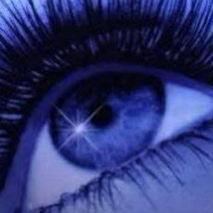
Introduction
The word atomos is a Greek word which has reference to the smallest entity imaginable and is the root or source for the word atom.
When the atom was first named, it was thought to be the smallest particle of matter that is indivisible.
Atomos is the word we translate “in the twinkling of an eye.”
Just how fast is the twinkling of an eye? The results and opinions varied in the research encountered. Any way one might consider, “the twinkling of an eye” is extremely fast.

Slide 14
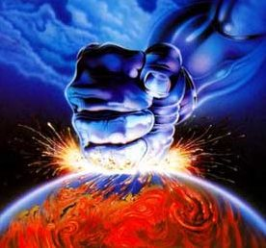
Introduction
Considering how quick an actual twinkling is, we can see it has significant implications relative to our transformation at Jesus’ return.
In 1 Corinthians 15:50-58, Paul speaks of Jesus’ return and our transformation happening in the twinkling of an eye.
There will be no time for repentance, prayer or baptism.
There will be no time to prepare ourselves.
In that fraction of a second, the dead will rise, and the living will be changed from mortal to immortal.

Slide 15
Introduction
In that same instant, 2 Thessalonians 1:6-10 indicates Jesus will be revealed from heaven with His mighty angels in flaming fire.
They will be taking vengeance on those who do not know God and do not obey the gospel of Jesus. Think about what was said.
The people subject to this punishment are not just those we might think of as evil or devoid of any knowledge of God.
Those who do not obey the gospel are also in peril.
That group includes those who reject the gospel altogether and those who have received the gospel message but decided not to obey.
Those who obeyed but are not fully obedient to the gospel of Jesus are also included.
1 Peter 4:17 warns us that judgment will begin with the house of God, which is the church.

Slide 16
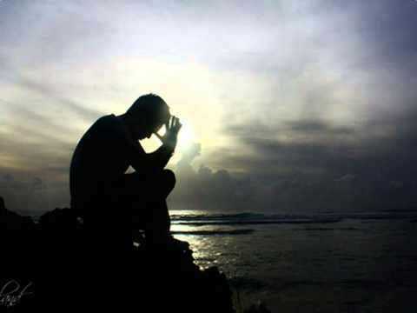
Introduction
What should we do?
Mark 13:33 tells us to watch in patience and pray because we do not know when the day of the Lord will come.
Verse 32 indicates no one knows when that day will come.
Not the angels or even Jesus Himself know.
Only God the Father knows the day and hour.
He will come as a thief in the night for those who are not prepared.
There will be no time to be reconciled to God when Jesus returns.

Slide 17
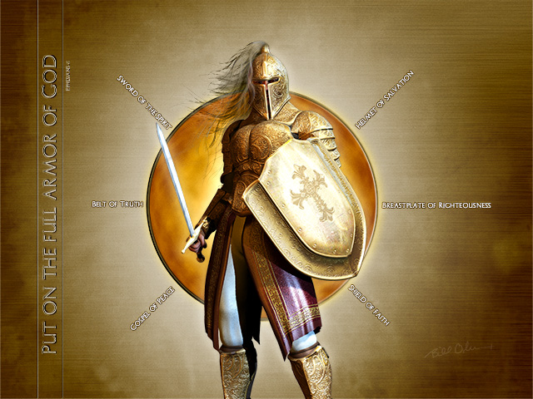
Deliverance from God Wrath
God wants us to be called from the darkness into His light.
Romans 13:11-12 instructs, "that, knowing the time, that now it is high time to awake out of sleep: for now is our salvation nearer than when we believed. The night is far spent, the day is at hand: let us therefore cast off the works of darkness, and let us put on the armour of light."
Paul calls it our “armour” as we are in a spiritual battle for souls.
The breastplate of righteous, faith and love, the sword of faith, and the helmet of salvation are part of that armor (1 Thes 5:8; Eph 6:13-17) as we battle in a spiritual war.
These weapons are mighty and powerful to bring every thought in obedience to God (2 Cor 10:3-5).

Slide 18
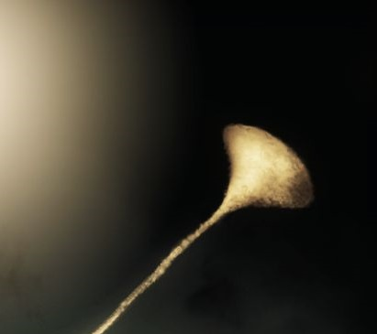
Deliverance from God Wrath
We must wait for Christ while living for God.
1 Thessalonians 1:10 teaches, "And to wait for his Son from heaven, whom he raised from the dead, even Jesus, which delivered us from the wrath to come."
Thus, we are called into the light of the day to live lives knowing that we will avoid the wrath of God and obtain salvation in the Christ.
1 Thessalonians 5:8-10 explains: "For they that sleep sleep in the night; and they that be drunken are drunken in the night. But let us, who are of the day, be sober, putting on the breastplate of faith and love; and for an helmet, the hope of salvation. For God hath not appointed us to wrath, but to obtain salvation by our Lord Jesus Christ, Who died for us, that, whether we wake or sleep, we should live together with him."
We can be ready when the trump of the Lord sounds.

Slide 19

Now Is the Time
Therefore, the time to prepare is now.
We are told in 2 Corinthians 6:2 now is the day of salvation.
Now is the time to be obedient to the gospel of Jesus: hear, believe, repent, confess, and be baptized.
Afterward, we can begin the work of being faithful unto death that we may receive a crown of righteousness (Rev 2:10b KJV).

Slide 20
Now Is the Time
We are taught to redeem the time.
What is hindering us from using the opportunities God has given to us?
Is it one of the many dark distortions of Satan?
Perhaps one of the most hideous of lies the Devil tells us that we have time. "God is not going to return tonight," Satan whispers. How do you know? Or how do you know that He might not call your time done?
He will return, and we will be transformed in the twinkling of an eye.
Some will be harvesting, working, and getting married at that moment.
Are you ready for that instant?

Slide 21
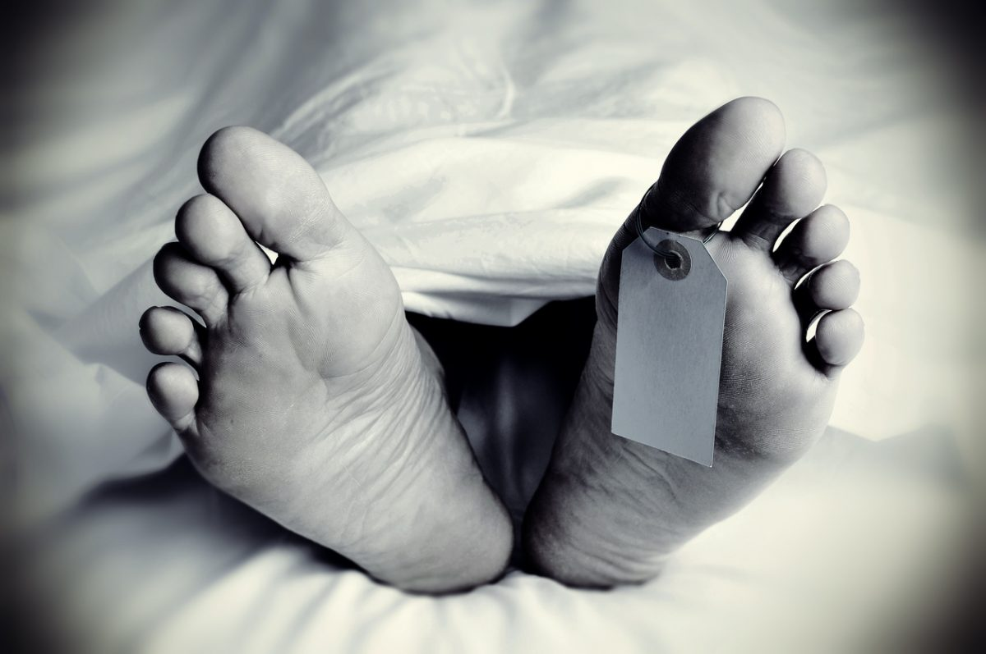
Now Is the Time
Death can come in an instant too.
A breath is all it takes for life to give way to death.
One second there is breath, the next there is none.
You can sit by a myriad of deathbeds, and even if it takes time for them to pass, it is the same.
There is always that instant—now breath, now no breath, the twinkling of an eye.

Slide 22
Obedience
The path from darkness to light starts with obedience, but our transformation takes a lifetime.
If we have obeyed but have not been faithful, now is the time to confess and repent of our sins so we may be forgiven (1 John 1:9).
We read in 2 Peter 3:9 that God is not willing for any to perish.
God does not want to condemn us with sin, and He has sacrificed His Son to allow us to escape His wrath.
Think about what Isaiah 43:25 records: “I, even I, am He who blots out your transgressions, for my own sake; And I will not remember your Sins.”
We must be obedient, faithful and diligent. I
f we are not God will punish us for our sins.
It is a fearful thing to fall into the hands of the living God (Heb 10:31).
If we wait too long to obey, in the twinkling of an eye it will be too late.

Slide 23
Review and Conclusion
We have learned we must use a lens of faith or prism of eternity to see heaven, God, and even ourselves as God sees us.
We have learned about many causes of spiritual blindness and how to cure it.
We have learned about the dangers of false teachers.
We have learned of the many lies Satan uses as tools to ensnare and enslave.
Among the Devil’s dark distortions are worldly trinkets and bobbles, disappointment, deception, drugs, division, prejudice, pride, hypocrisy, and self-righteousness.
We have learned about the insidious nature of sin that we often let grow in our blind spot.
We have learned about the lies of covetousness Satan employs to capture people into pornography, immoral sexuality, and greed as opposed to God’s plan of sanctification.
All of these snares are when we fail to recognize that God is not enough!

Slide 24
Review and Conclusion
We have also explored the Light and how God is the Creator and Light.
We have also considered how He has given us His love, light, and holiness.
This study should cause us to focus our eyes on Christ and to carry the light through service in God’s kingdom.
We learned to look to the parables for how Christ sees Himself, and thus also our own condition.
We learned not to be wise in our own eyes but in the light of God’s wisdom and righteousness.
The fleshly or temporal focused person may not be able to see the light of heaven’s love, kindness, grace, and joy, but the spiritually focused can see these things.

Slide 25
Review and Conclusion
Ultimately, we understand we walk by faith and not by sight.
Christians must seek to walk in the light to build their lives and families.
By knowing that God is enough, they can focus on the eternal rather than the temporal, laying up their treasures in heaven and living this life in that joy.
The value of the whole world is insignificant to the value of one’s soul.
These lessons are only relevant if we use them in our lives–to grow and mature in service to God.
Otherwise, we will face the wrath instead of the place Jesus has prepared (John 14:1-3; 1 Thes 1:10; 1 Thes 4:13-17; 1 Thes 5:9; Titus 2:13).

